Slide 1
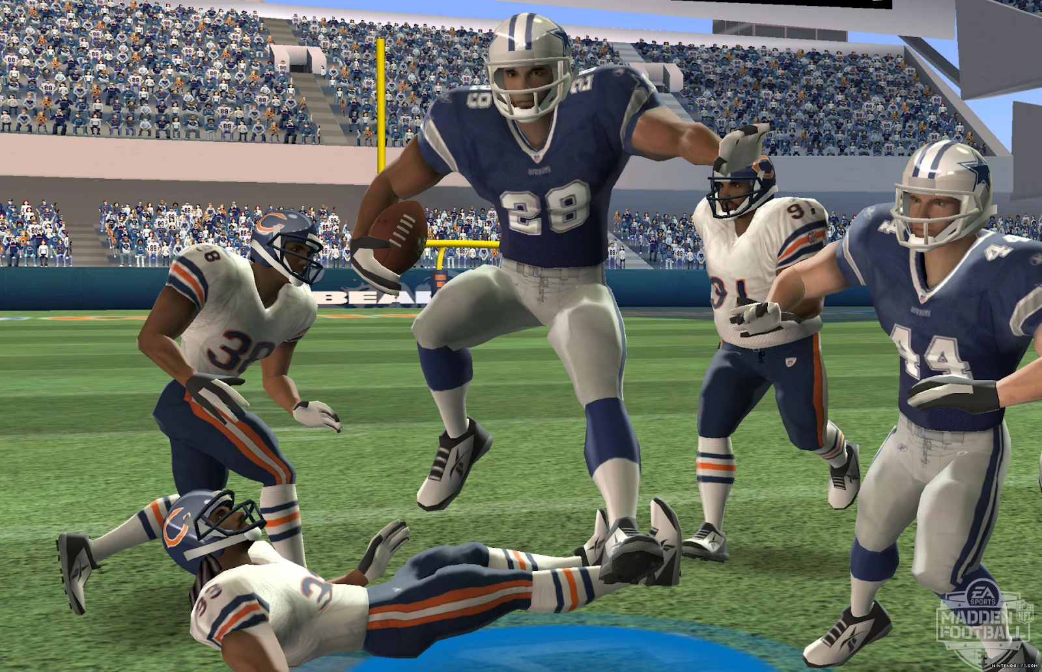
DS501 Project 4 NFL Big Data Bowl
Mia Barger ▪ Quincy Hershey ▪ Alexander Moore ▪ Ethan Prihar

Slide 2
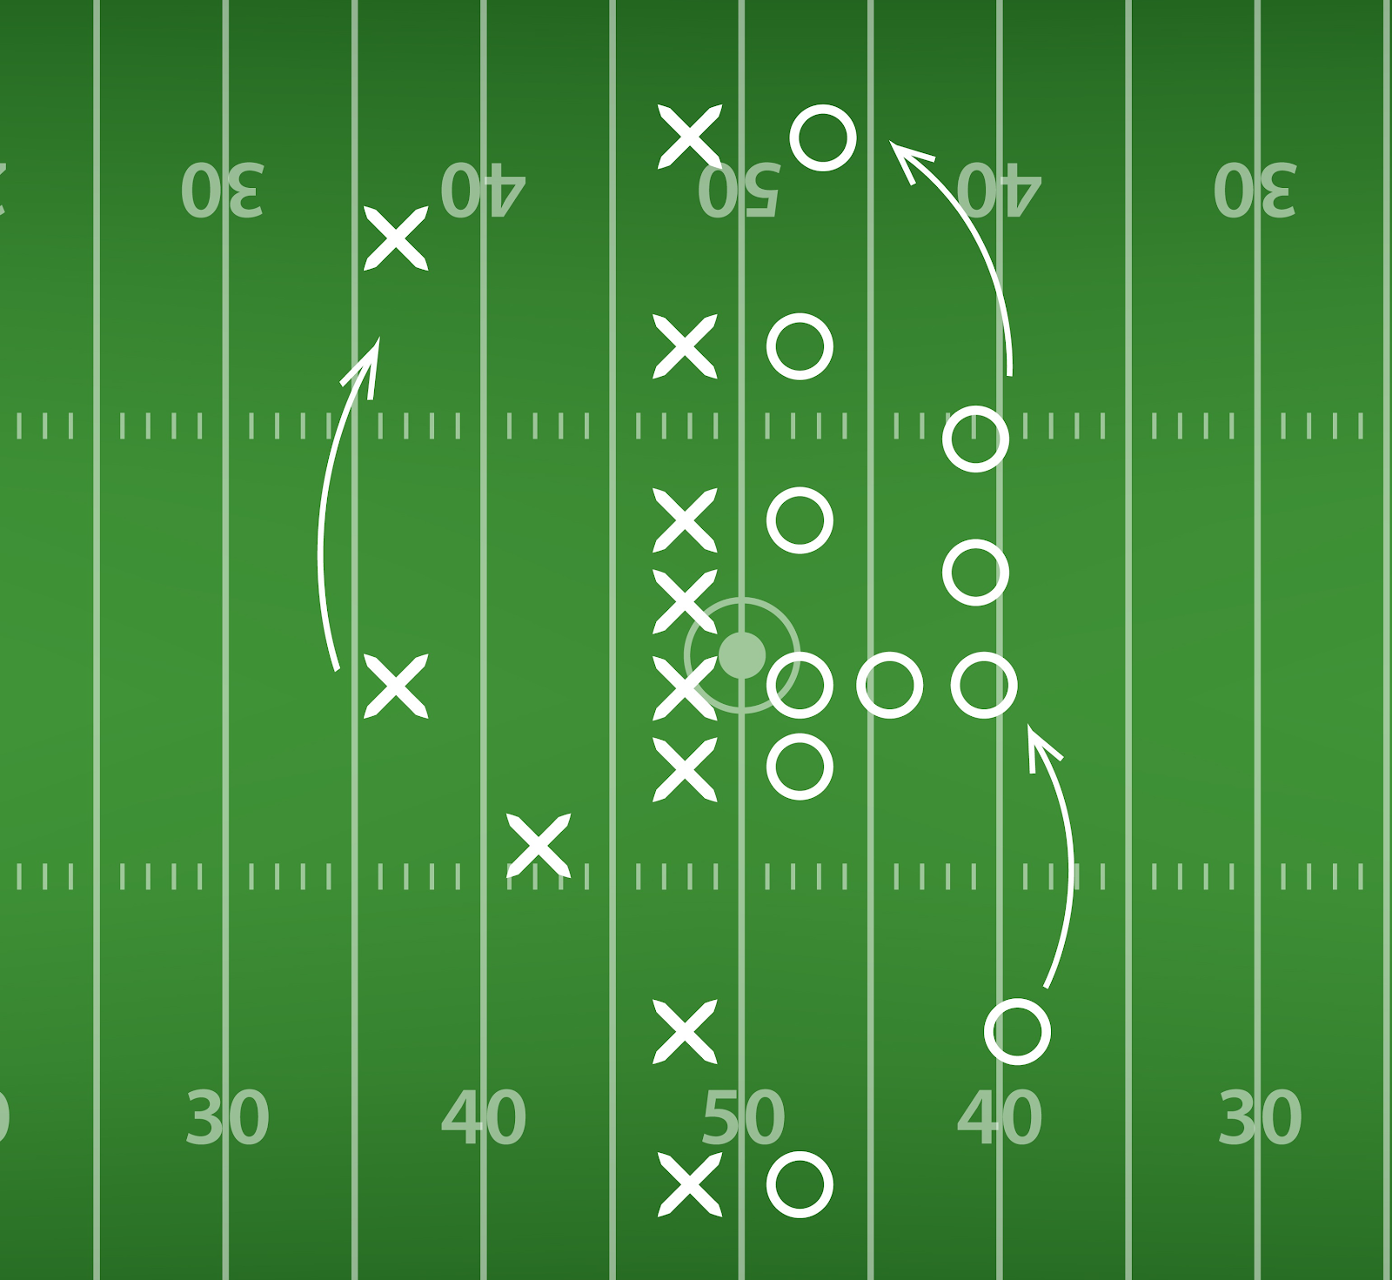
Kaggle Competition to Predict Yardage
Training data of 23,000 rushing plays across 49 features

Slide 3
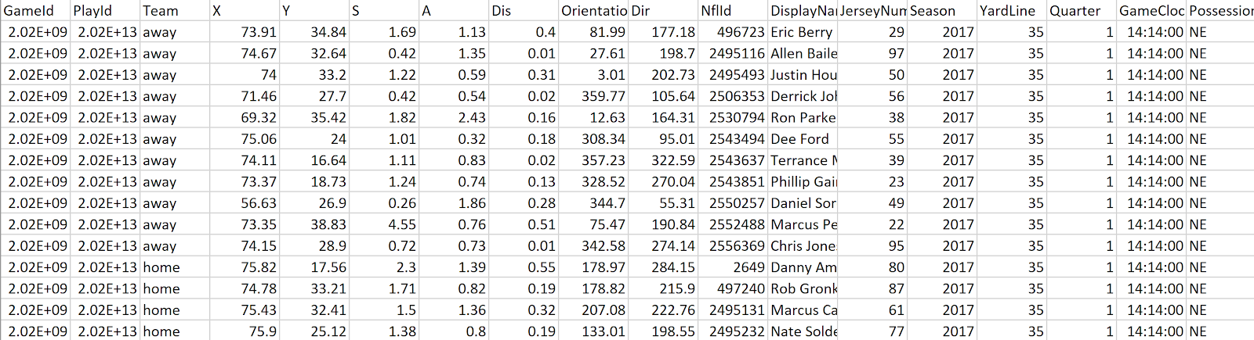
Data Problems
Single features independent to target, complex plays

Slide 4
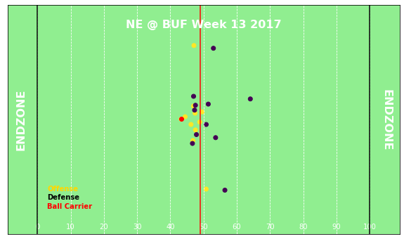
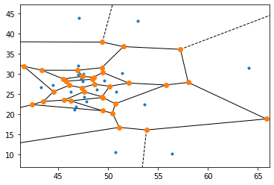
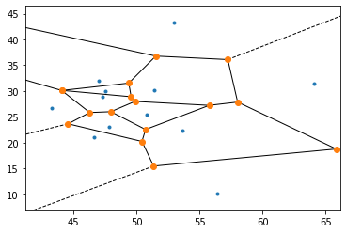
Visualizing the Problem

Slide 5
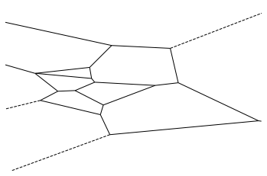
Visualizing the Problem

Slide 6
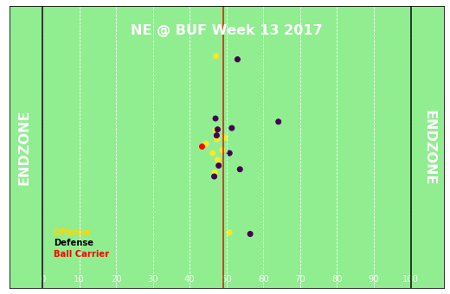
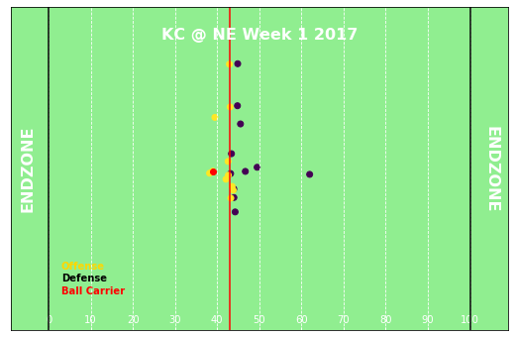
Comparing Outcomes
NE 3 BUF 0 1st and 10 8:41 2nd Quarter
Offense: I-formation Defense: 7 in the box
Weather: 48 degrees, cloudy Yards gained: 44
NE 0 KC 0 1st and 10 13:52 1st Quarter
Offense: Shotgun Defense: 6 in the box
Weather: 63 degrees, clear Yards gained: 3

Slide 7
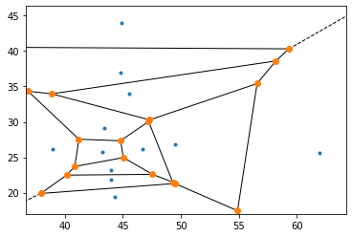
Comparing Outcomes

Slide 8
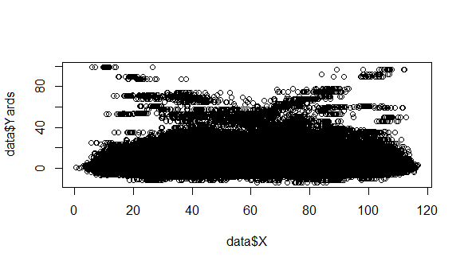
Data Analysis

Slide 9
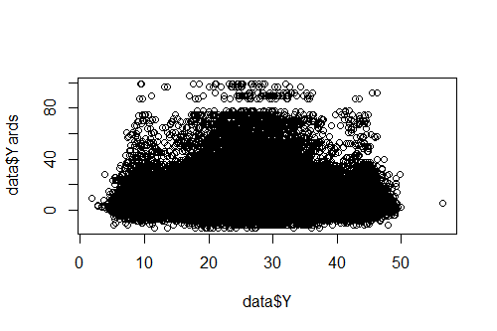
Data Analysis

Slide 10
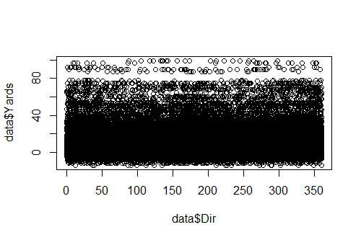
Data Analysis

Slide 11
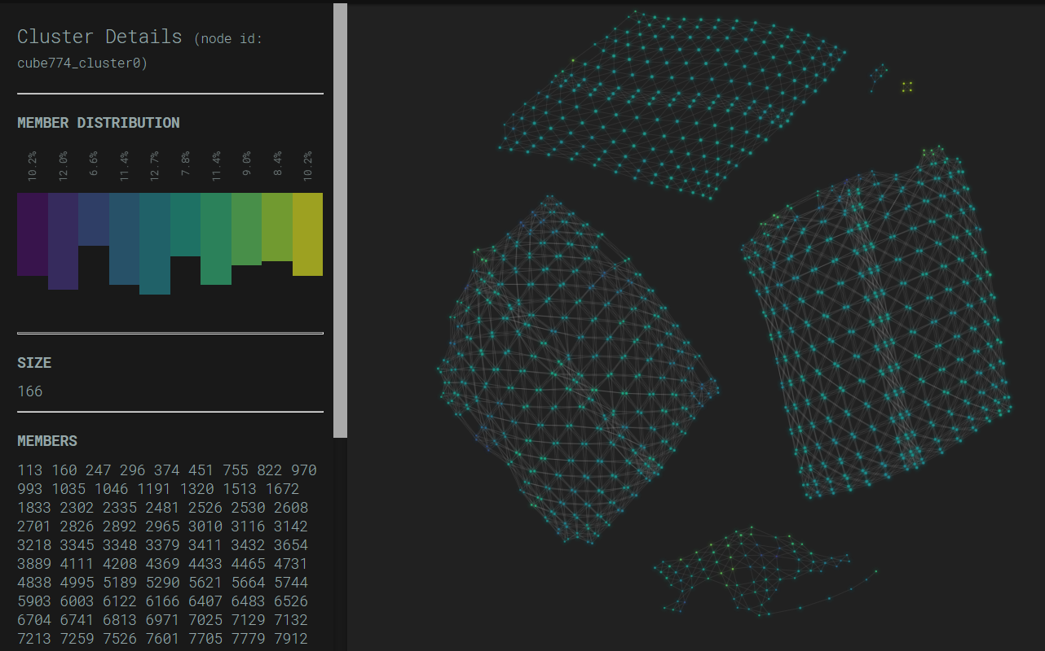
Principal Component Analysis

Slide 12
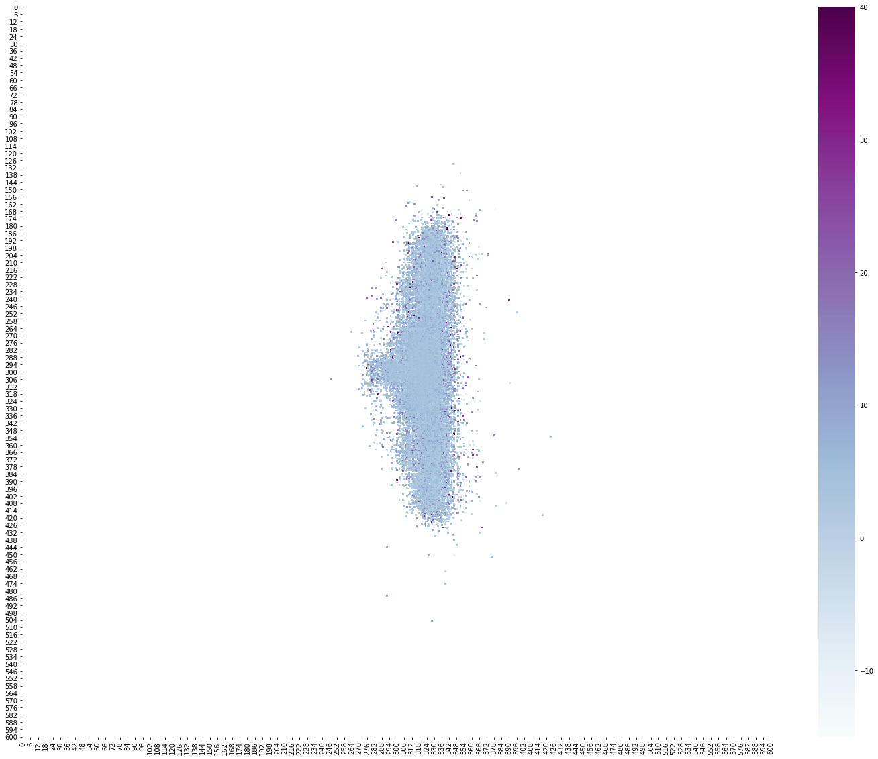
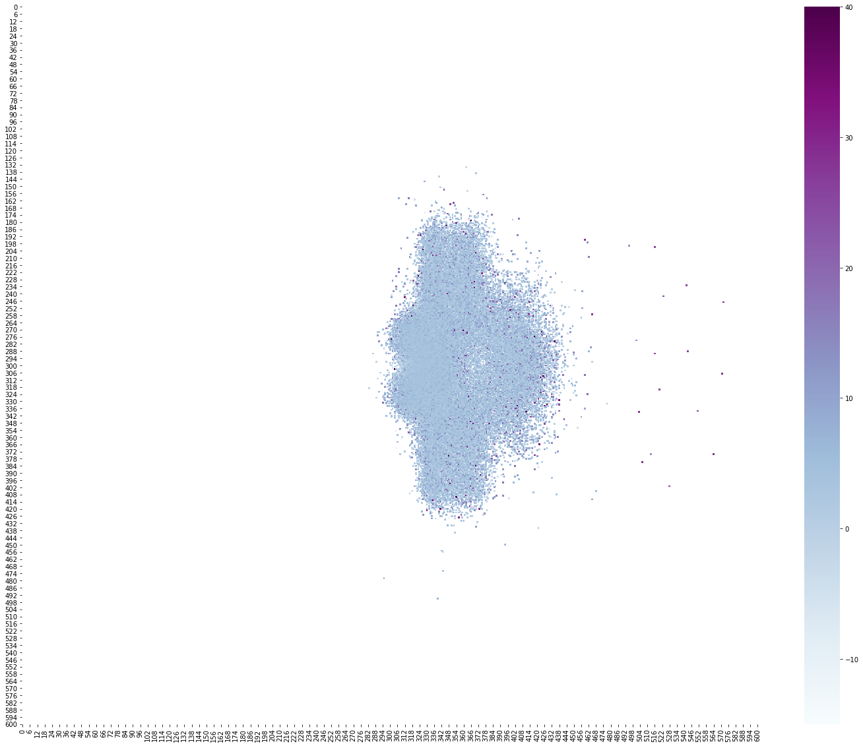
Data Characteristics
Offensive Formations
Defensive Formations

Slide 13
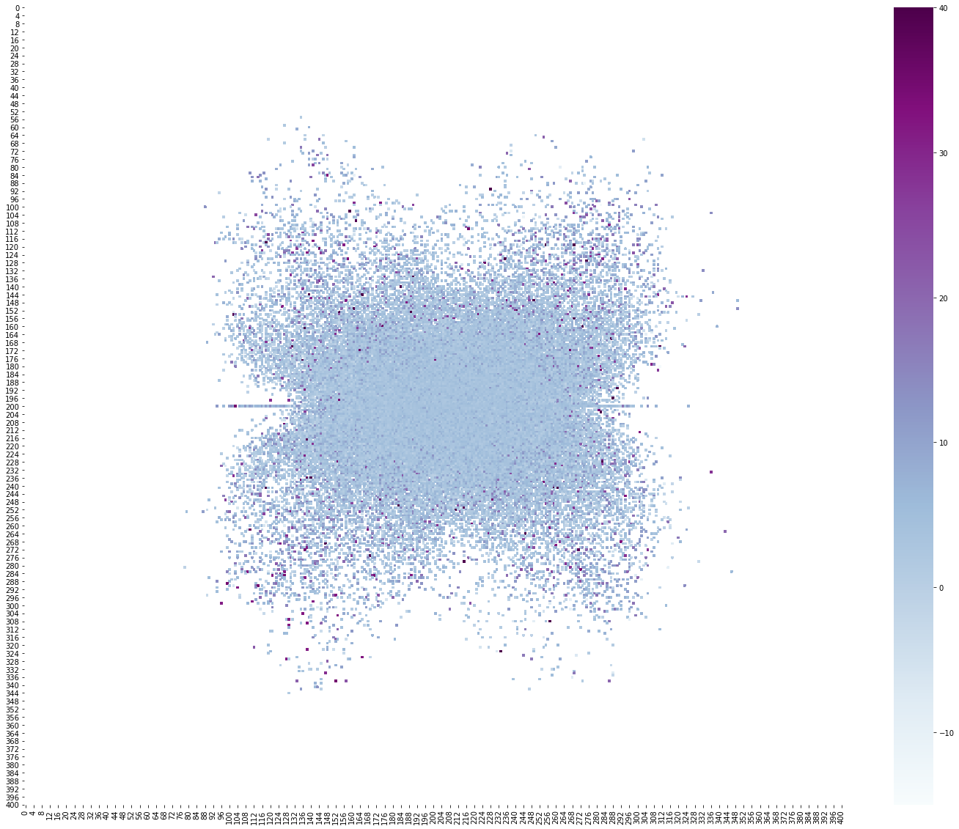
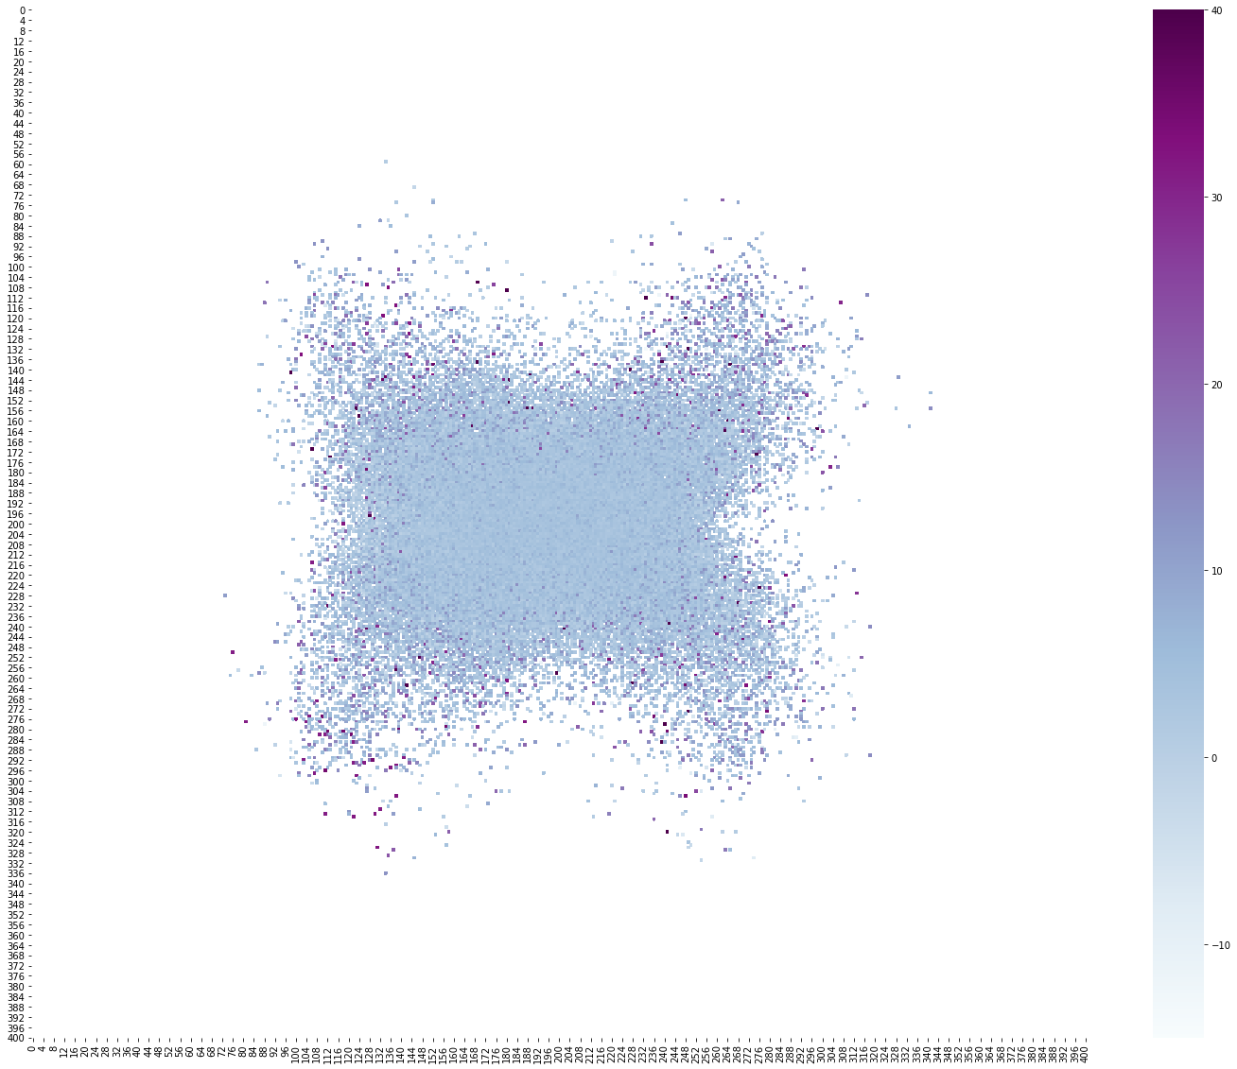
Data Characteristics
Offensive Velocity
Defensive Velocity

Slide 14
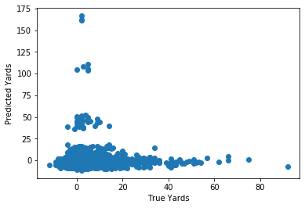
Model Comparison
Model: | Average Value | Linear Regression | Regression Tree | Neural Network
MSE: | 38.01 | 37.24 | 38.73 | 47.88
Most important features
Offensive formation
Defensive backs

Slide 15
Conclusions
Linear regression slightly improved from the zero-r model
Next steps:
Robust feature extraction
Physics model

